Slide 1
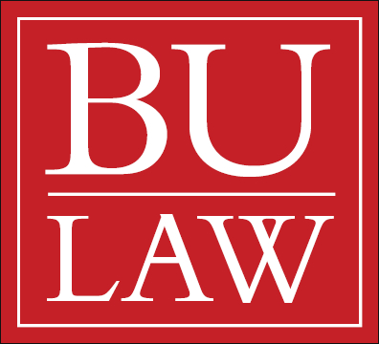
New Business Models for Preventing and Treating Bacterial Diseases House Energy & Commerce Committee September 19, 2014
Kevin Outterson
mko@bu.edu

Slide 2
A Serious Problem
Source: National Vital Statistics Report (NVSR) “Deaths: Final Data for 2011.” Data for ABR + c. diff. is from CDC, Antibiotic Resistance Threats in the US, 2013

Slide 3
Private Net Present Value (NPV) Model

Slide 4
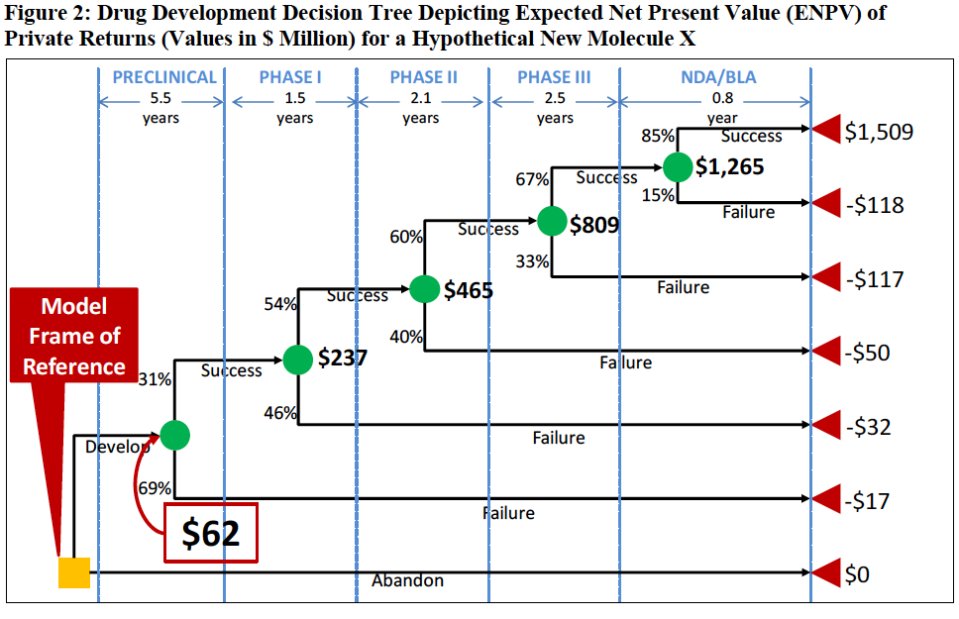

Slide 5
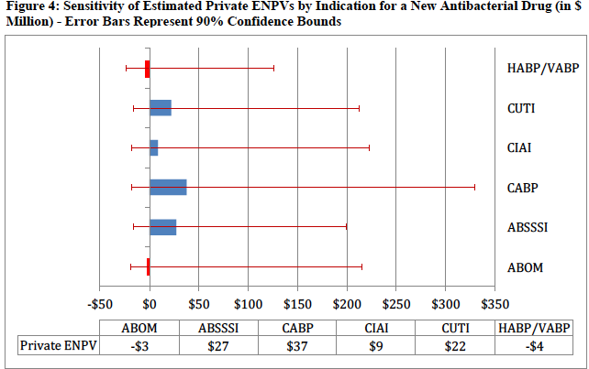
Broken Business Model
Source: Eastern Research Group. Analytical Framework for Examining the Value of Antibacterial Products (April 2014). Available at: http://aspe.hhs.gov/sp/reports/2014/antibacterials/rpt_antibacterials.cfm.

Slide 6
Social Net Present Value (NPV) Model

Slide 7
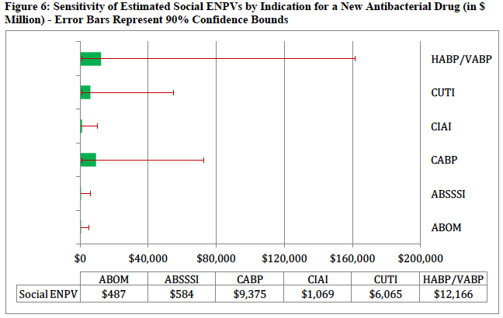
Social NPVs
Source: Eastern Research Group. Analytical Framework for Examining the Value of Antibacterial Products (April 2014). Available at: http://aspe.hhs.gov/sp/reports/2014/antibacterials/rpt_antibacterials.cfm.

Slide 8
Comparison
Source: Author’s analysis of ERG 2014.

Slide 9
Source: Author’s analysis of ERG 2014. Annual US private and social ENPV by indication, in millions of US$

Slide 10
Source: Author’s analysis of ERG 2014. Annual US private and social ENPV by indication, in millions of US$; social values truncated at $100 million to show private detail

Slide 11
Evaluating Incentives for Antibacterial Drug Development

Slide 12
Incentive Categories
TYPE | CONSERVATION | PRODUCTION
Property | Intellectual property (IP) used as conservation tools to privately constrain demand | Intellectual property (IP) used as incentives to bring new antibiotics to market
Regulation | Public health infection control and antibiotic stewardship programs regulate demand for antibiotics | FDA regulations relaxed to speed approval of new antibiotics. Tax subsidies support R&D
Contract | Prizes, grants, and value-based reimbursement support antibiotic conservation. | Prizes, grants, and value-based reimbursement support new antibiotic production.
Tort | Patients sue for hospital-associated infections, increasing institutional incentives to promote safety through antibiotic conservation | Federal law designed to preempt state tort law, waiving drug company tort liability for antibiotics
Source: Kesselheim and Outterson, 2010
Note: IP collectively refers to Patents, Data Exclusivity (DE), Marketing Exclusivity (ME), Patent Term Adjustments (PTAs), Patent Term Extensions (PTEs), and Supplementary Protection Certificates (SPCs). Even though these are treated in a similar fashion in the model, they vary in terms of purview, structure, and expected impacts.

Slide 13
Incentives in Detail
Education campaigns to encourage appropriate use of antibiotics
Regulate the procurement and marketing chain through an ISO standard for public procurement and accreditation of informal drug dispensers in the developing world
Expand promotion of vaccination
Encourage antibiotic substitutes, such as free or heavily discounted “cold kits” to physicians
Coordinate infection control regionally and facilitate cooperation among hospitals
Expand surveillance of resistance
…
Provide transparency on institutional infection rates and resistance levels
 | CONSERVATION
REGULATION | Public health infection control and antibiotic stewardship programs regulate demand for antibiotics

Slide 14
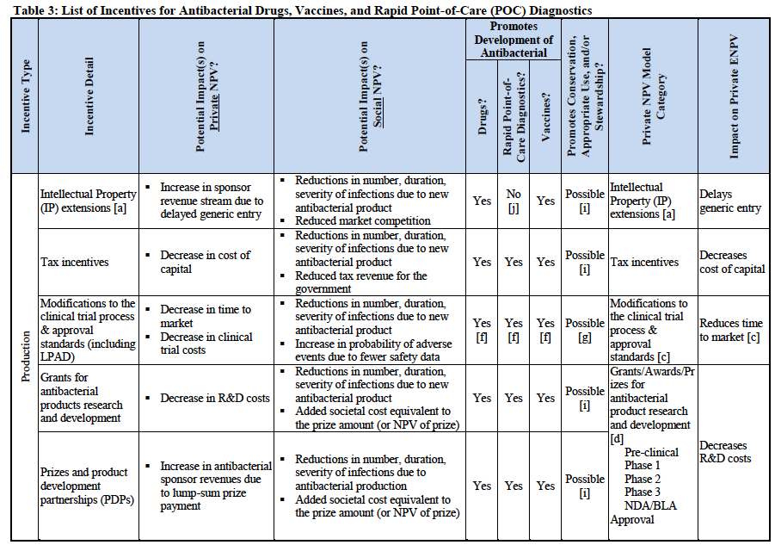
Production Incentives

Slide 15
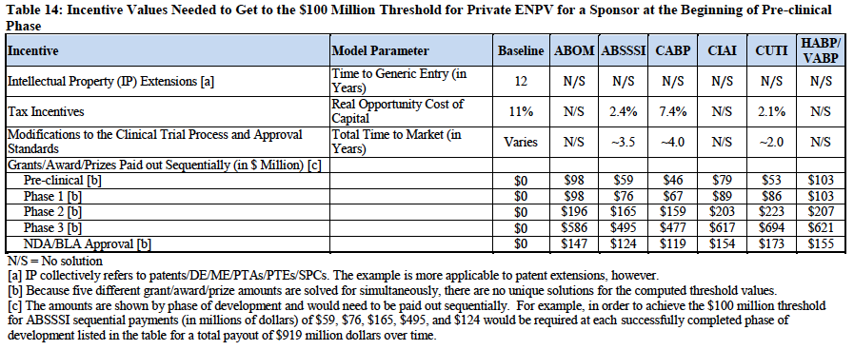
Incentive Results
ERG Report, 3-16 to -18

Slide 16
What Works
Cost of capital reductions through fully refundable tax credits and/or grants should be in the range of 50%
Milestone payments, approval prizes and enhanced rbx can significantly improve NPV if large enough (~$1 billion/approval)

Slide 17
Less Likely
IP (patents, market exclusivity, data exclusivity) will not significantly impact NPV
Further (feasible) reductions in clinical trial size and time will not significantly impact NPV

Slide 18
New Business Models for Preventing and Treating Bacterial Diseases House Energy & Commerce Committee September 19, 2014
Kevin Outterson
mko@bu.edu

